Slide 1
WHAT IS A MUSEUM?

Slide 2
A museum is a building that looks after a collection of objects that are found in nature or objects that people have created.

Slide 3
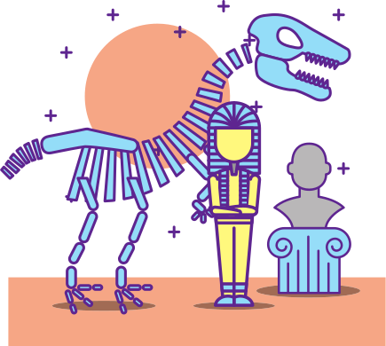
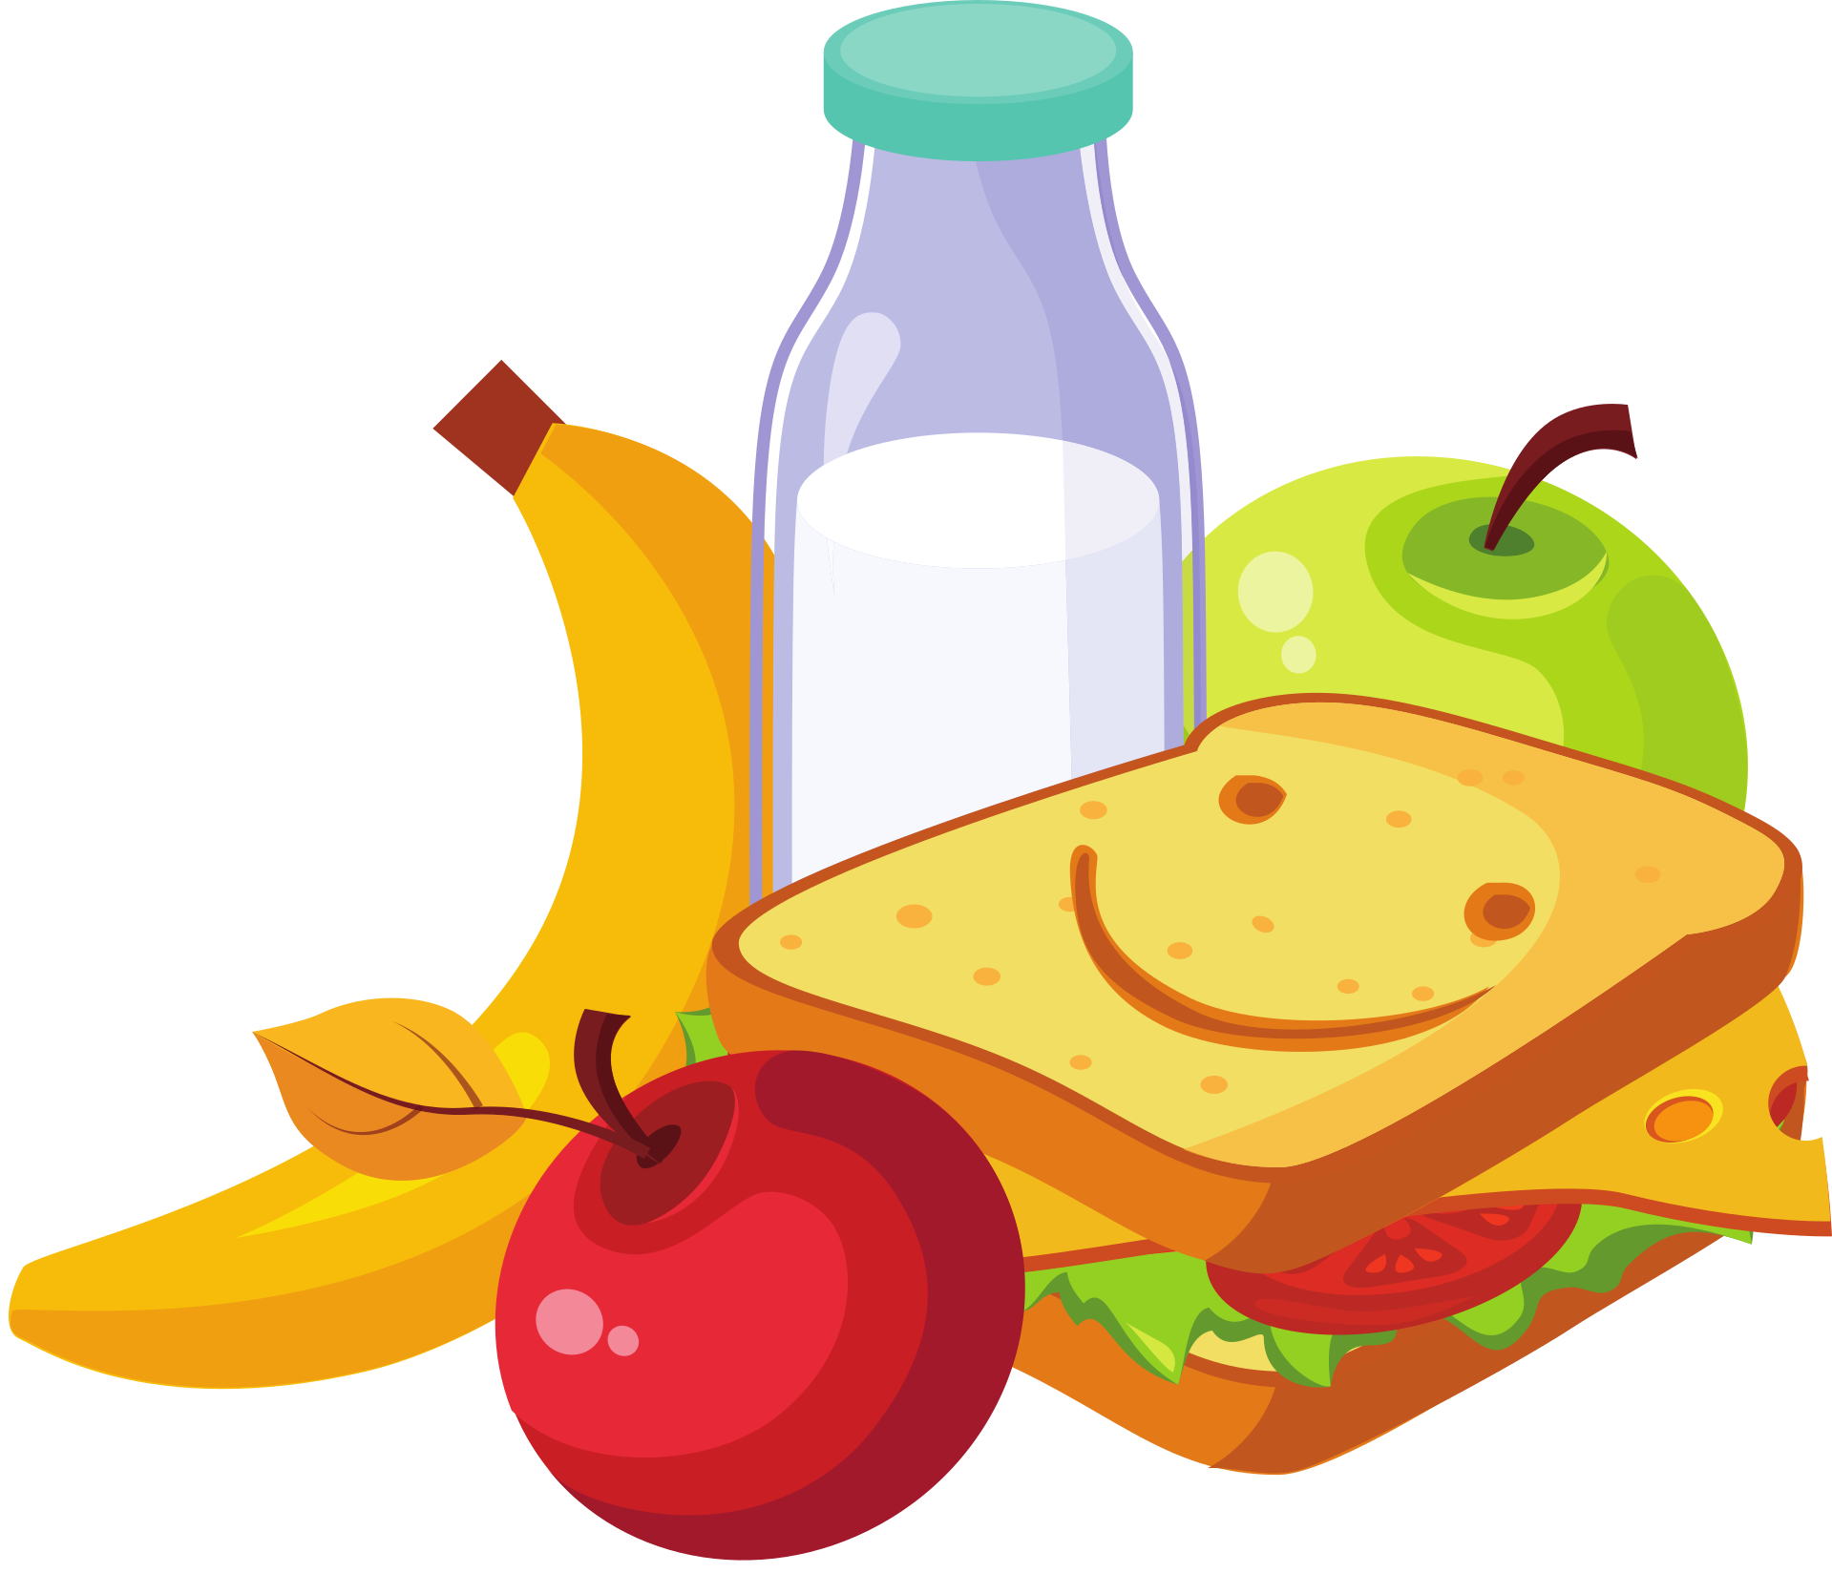
museums can be so much more...
Museums are a place of discovery, but they can also be a place to grab a quick drink, some lunch, meet your friends. You can take part in events, learn a new skill, volunteer…you can EVEN work there...
museums are part of your community

Slide 4
Some museums focus on a single subject—for example, art, science, or history.
Others focus on a specific place or time, and collect lots of different things about that place or time.

Slide 5
IMAGINE if your PE class had a museum, it might have things like trophies, gym equipment, maybe even photos of sport teams over the years.
Now imagine if your entire school had a museum, what would it include?

Slide 6
MY LOCAL ROADS MUSEUM
Ticket desk
Different types of vehicles and road signs I see out my window
Shop & cafe, toilets

