Slide 1
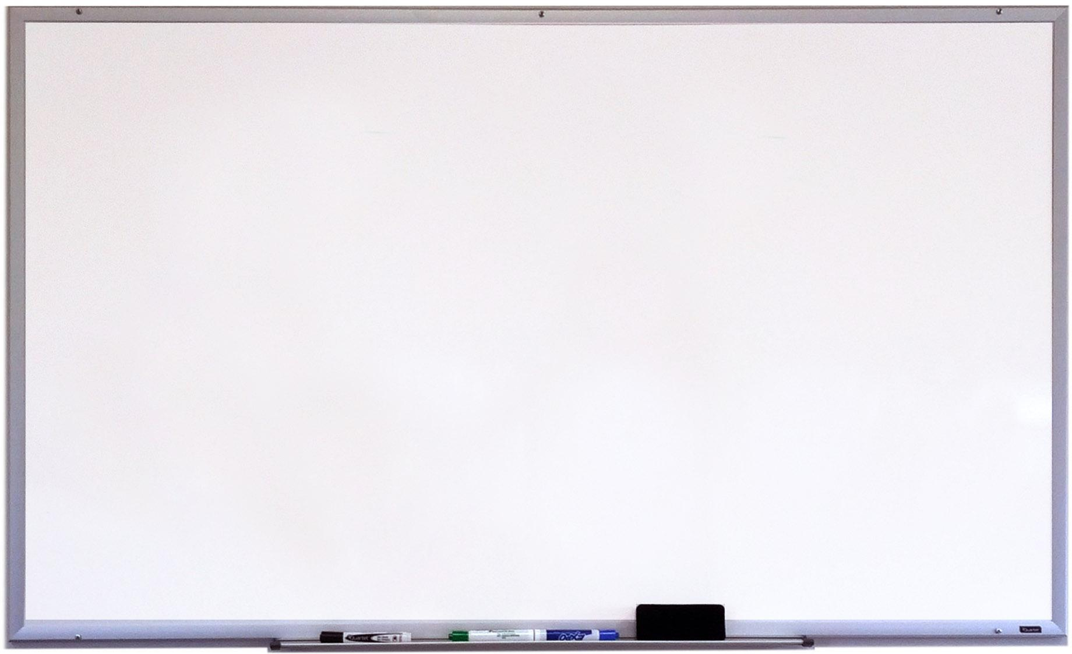
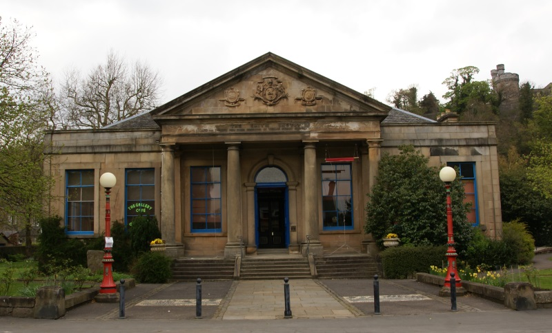
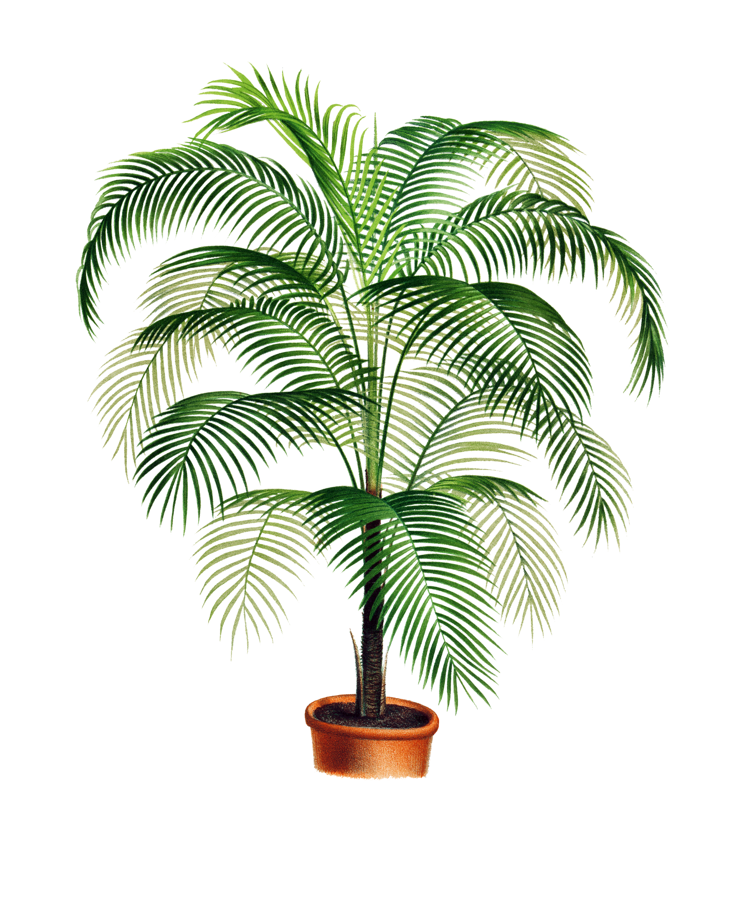
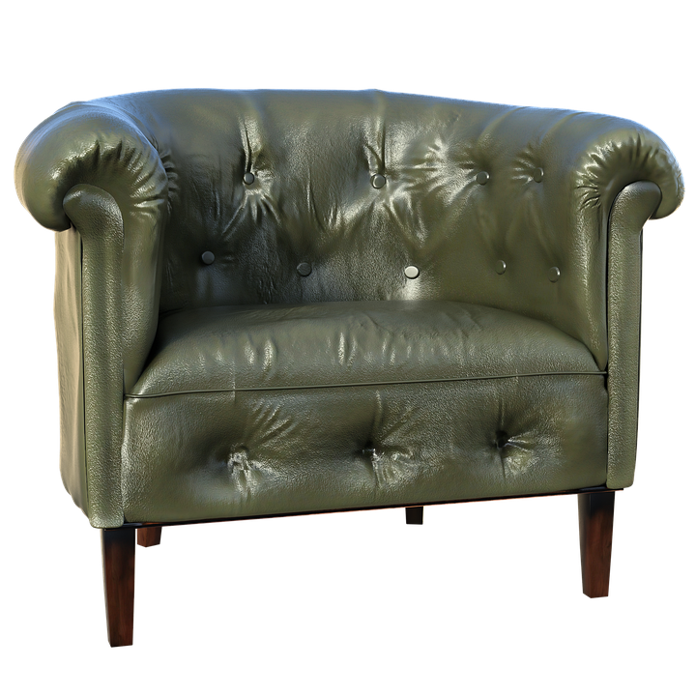
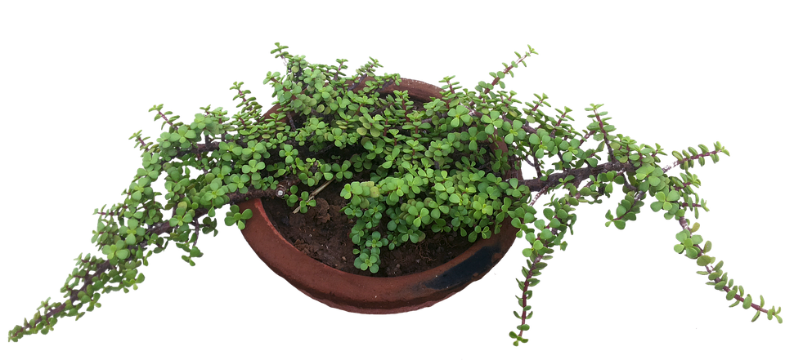
Welcome to our Museums and Art Galleries Virtual Classroom
Tasks to complete
Visit the Smith Museum and Art Gallery
What are Skills?
The Getty Museum Art Challenge
Skills profile questionnaire
The Pipe of Freedom
Make your own museum
What are Museums?

