Slide 1
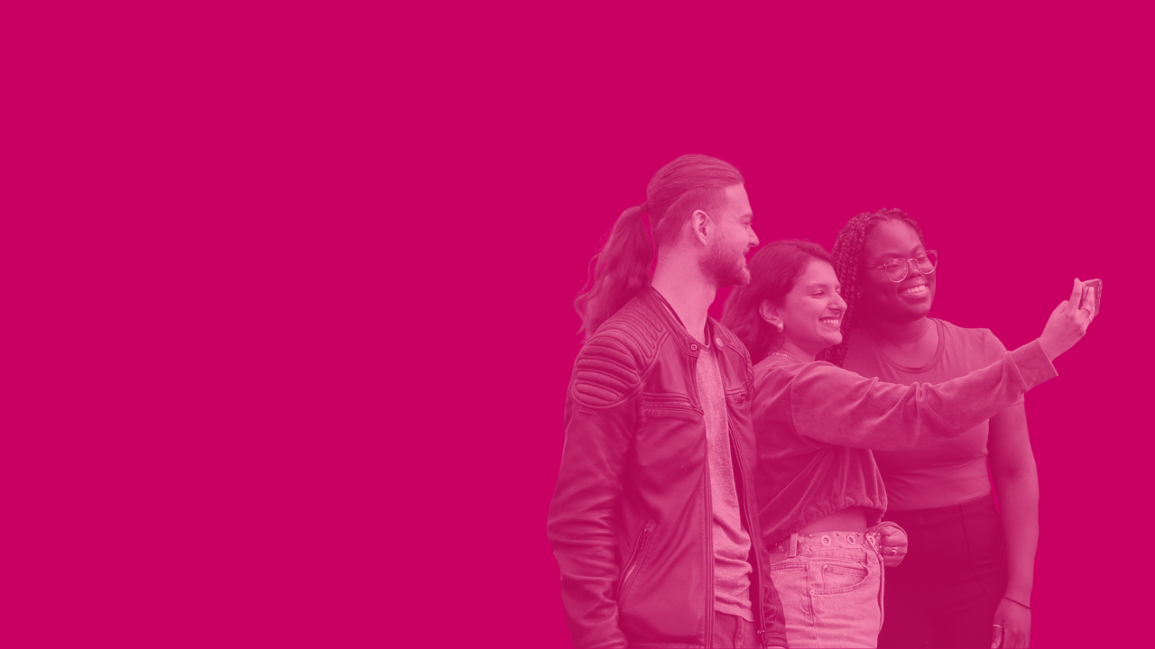

Making the most of your social media
Museum Futures | Lunch & Learn
Joe Setch (he/him)
Marketing & Communications Officer,
Museums Galleries Scotland

Slide 2

This Lunch & Learn
will help you to:
Think strategically about social media
Understand your audiences
Create compelling content
Evaluate your impact
Notes:
This presentation starts with the principles that underpin success on social media, followed by some real-world examples from Scottish museums.

Slide 3
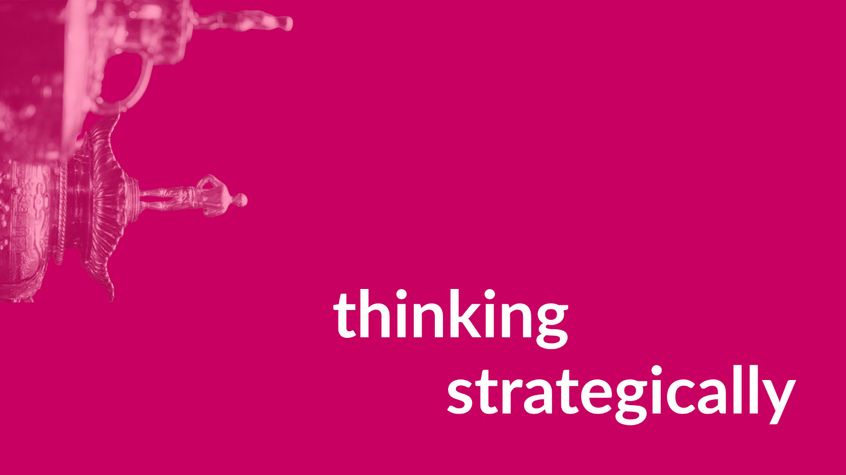
Thinking Strategically

Slide 4
Strategy
Social media is just one part of your wider marketing strategy
Each social media platform has strengths and weaknesses – and not everything is right for social media.
No matter your strategy, certain principles always apply. Focus on consistency: get the basics right, and balance quality with quantity. Be responsive.
Marketing can be built into all areas of your museum’s work. Chat with your colleagues to identify how their work can support your organisation’s marketing and social media objectives.
Notes:
Your social media presence exists to serve your organisational objectives. You only have limited time and manpower to devote to social media, so you need to work smart and identify your priorities.
A successful social media strategy starts with your organisation’s overall marketing plan. A lot of the big decisions about your social media presence should be made at this level. This plan should set out your goals as an organisation, profile your key target audiences, and outline how you can achieve your goals by reaching these key audiences. Your plan should summarise your mission and values, as this will shape the distinct visuals, personality, and messaging of your marketing and communications. Having this marketing plan in place will ensure that your social media is serving a purpose.
Social media is a versatile tool that can be used to support a wide range of marketing goals. But each platform has unique audiences and different strengths and weaknesses. What works on one platform may not work on another – and not everything is right for social media. It should be used alongside other tools such as your website, mailing lists, media coverage, print materials, and advertising.
Details about the strengths and weaknesses of different platforms can be found in the social media toolkit on the MGS website: https://www.museumsgalleriesscotland.org.uk/advice-article/social-media-toolkit/
No matter your strategy, certain principles always apply. Focus on consistency (e.g. : tone, posting schedule, image quality, messaging), get the basics right (e.g. up-to-date information, regular monitoring, clear profile pictures and cover images), and balance quality with quantity. Be responsive – engage with comments and messages.

Slide 5
Let’s talk about goals
Social media can help you…
Be discovered (attract new audiences)
Build loyalty (appeal to existing audiences)
Raise awareness (of your mission, values, collections, projects)
Promote your offer (events, exhibitions, amenities, retail)
Enhance your reputation (all of the above)
All your actions on social media should be goal-oriented - but not everything should be a hard sell.
Notes:
Your challenge is to translate your marketing goals into compelling social media content.
All your actions on social media should be goal-oriented - but not everything should be a hard sell. By this, I mean that your content should include a mix of concrete calls-to-action (e.g. visit our museum, sign up for this event, read our blog article) and more subtle content that still fulfils your objectives (e.g. a nice view of the museum on a sunny day, or a picture of visitors having a fun time).

Slide 6
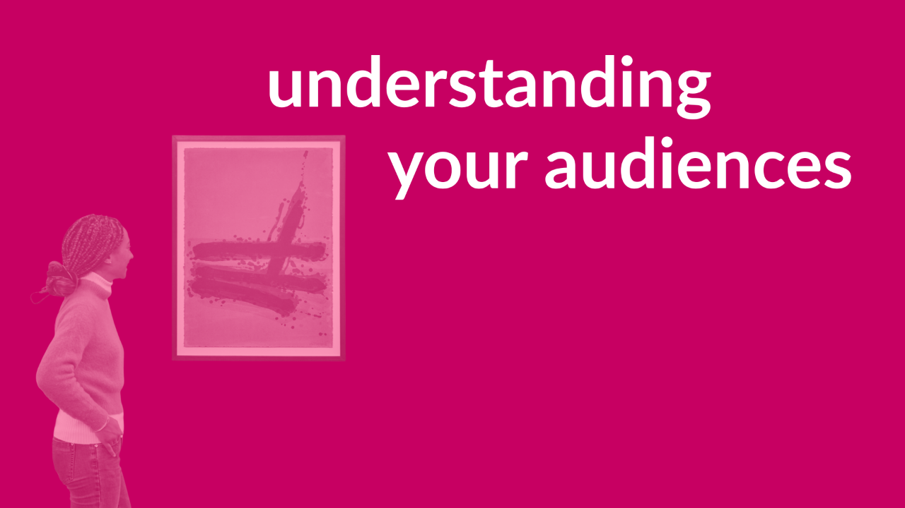
Understanding your audiences
Notes:
Once you’ve thought about your goals, it’s time to understand your audiences.

Slide 7
Give the people what they want
Why do we use social media?
What motivates us to like, comment on, and repost content?
We seek inspiration, entertainment, escapism, participation, information
We want to feel seen, heard, involved, understood, and in on the joke – community
We want to build relationships, feel a connection, and a sense of belonging – human stories
We want authenticity and enthusiasm – a coherent personality
Your goal is to always create content that a chunk of your audience feels passionately about.
Notes:
The content you create should fulfil your marketing goals. But it’s only going to succeed if you can meet people’s needs – not only as a venue, but also as a content creator. So we need to understand what people want and expect from social media.
Pragmatically, you need to stir emotions to get likes and shares. And these likes and shares in turn help you reach new audiences.

Slide 8
Audience profiles
Start with key demographics/profiles that you’ve identified in your marketing plan. This may be a mix of new and existing audiences.
Put yourself in their shoes.
What do they want from a museum?
Can you fulfil these wants?
If so, can your social media accounts be used to communicate this?
Unsure what your target audience wants? Do some market research!
Notes:
Of course, different people have different needs. That’s why it’s handy to break your target audience down into manageable chunks.
Audience profiles may include: families, retired daytrippers, local gen Zers. Let’s take the last example. They want a low-cost, relaxing, place to visit with their friends. Somewhere that’s accessible, potentially by public transport. Somewhere that looks good on their own social media accounts. Somewhere that does a nice coffee. To make it clear that you can fulfil these wants, you might want to share a video that follows the route to your museum from the nearest train station. Use friendly, casual language to communicate that your museum is a relaxed environment. Share photos of young people enjoying your café.
Unsure what your target audience wants? Do some market research! Talk to this demographic. Find out what they like about your museum. Find out what sort of social media content they enjoy. How can you meet their expectations?

Slide 9
How to reach the right audiences
What social media platforms do your target audiences use?
Tap into existing audiences – engage with community pages, work with influencers, collaborate with community groups and local businesses
Create aspirational content – your aim is to generate reposts, get recommended on news feeds, and become a talking point
Social media advertising – low-cost targeting with in-depth reporting
Create discoverable content – work with the algorithms, and consider search engine optimization (SEO)
Notes:
Once you’ve identified your audiences, you need to know how to reach them on social media.

Slide 10
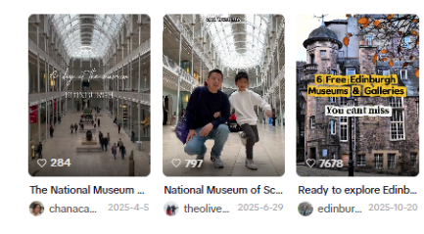
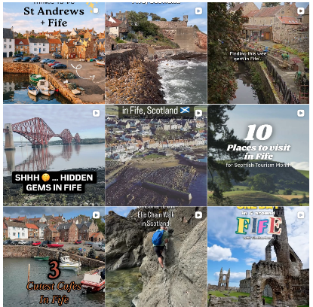
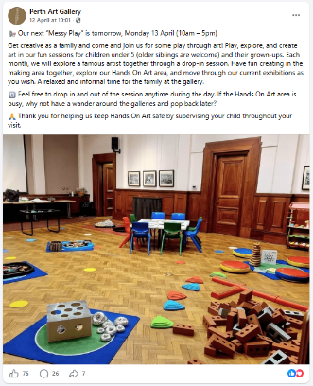
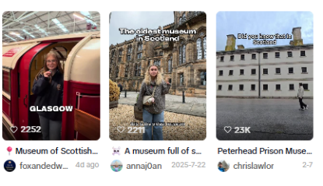
Social media as a search engine
‘Things to do in Fife’ on Instagram
‘Scottish museum’ on TikTok
‘Family day out in Perth’ on Facebook
Notes:
Social media is increasingly being used as a search engine, and social media posts can show up in search engine results. So incorporate key terms into your social media content to get on the radar of your target audiences.
The Instagram screenshot on this slide features Fife Folk Museum in the top right. The Facebook screenshot showcases the activities available at Perth Art Gallery, with text which outlines who the activity is for, and that it’s free to access.

Slide 11
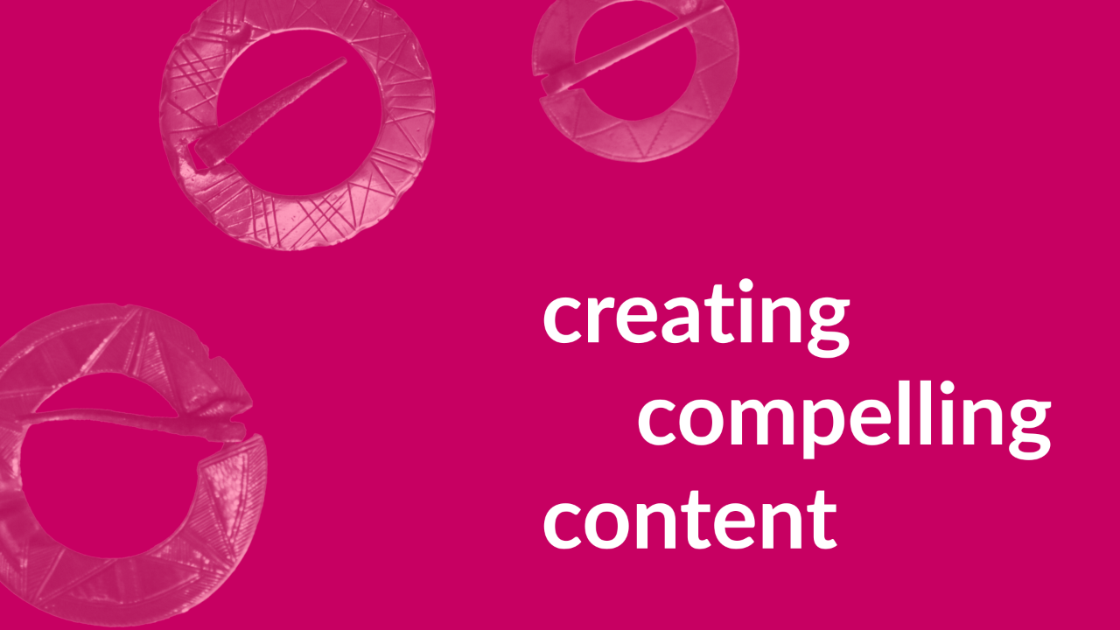
Creating compelling content
Notes:
Now that you’ve identified your marketing goals and gained an understanding of your audiences, you can create compelling content for them.

Slide 12
Strengths and skills
What are the strengths of you and your team? Put this at the heart of your content creation.
Have fun – people love authentic enthusiasm. What do you have fun with at your museum?
Share your passions – let them shine! It doesn’t need to be polished – but it does need to be appealing.
Don’t be afraid to try new things, or adapt popular formats – it’s all good practice
Notes:
Possible skills: Are you a good photographer? Are you funny? Do you build strong connections with visitors? Do you follow social media trends? Are you a good storyteller? Are you comfortable in front of a camera? Do you have an area of expertise? This goes back to that idea of chatting with your colleagues to find opportunities for their work to align with your marketing goals.

Slide 13
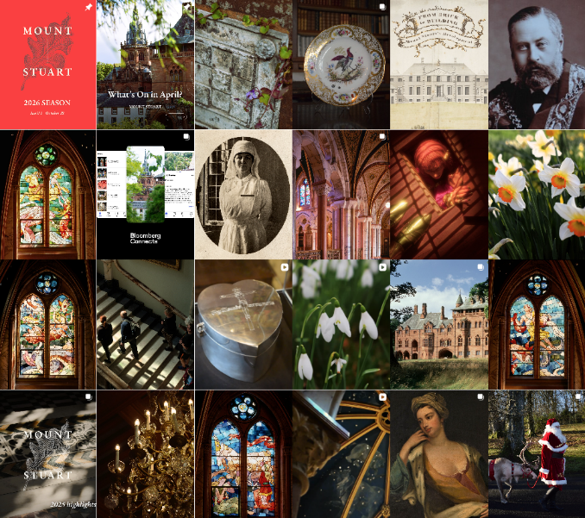
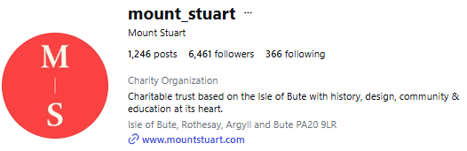
Sophisticated
Exclusive
Luxurious
Serious
Warm
Notes:
When creating content, first impressions count! This is why it’s so important to translate your values and mission into a distinct personality, voice, and visual identity. If a potential visitor is scrolling quickly through your social media, this may be your one opportunity to convince them to visit – so it needs to do a good job of promoting the vibe of your venue.
The next few slides all feature screenshots of museum Instagram accounts. Note how each museum posts content that effectively communicates their overall atmosphere.

Slide 14
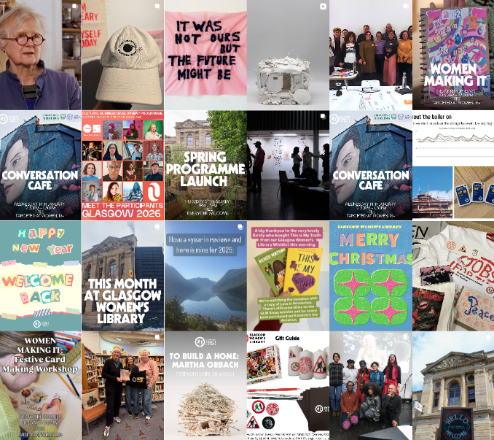
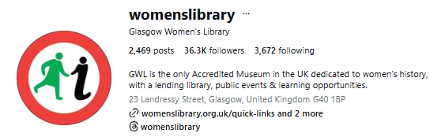
Bright
Friendly
Relaxed
Togetherness
Font – bold, bright, confident

Slide 15
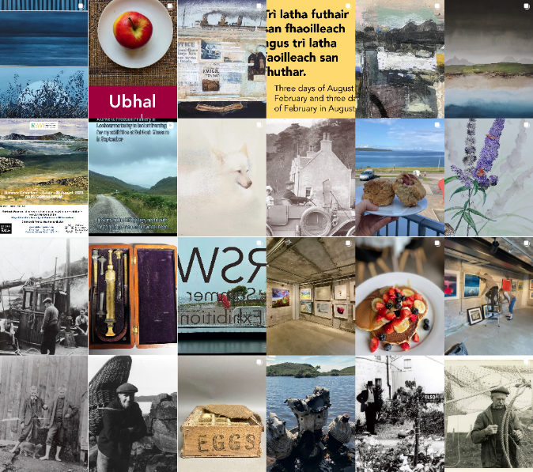
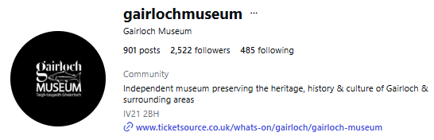
Fresh
Beachy
Spacious
Relaxed
Historic

Slide 16
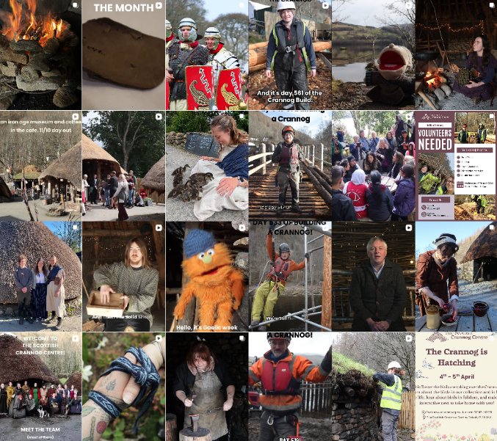
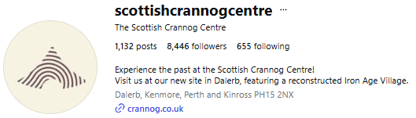
Earthy
Cosy
Warm
Friendly
Person-centred

Slide 17
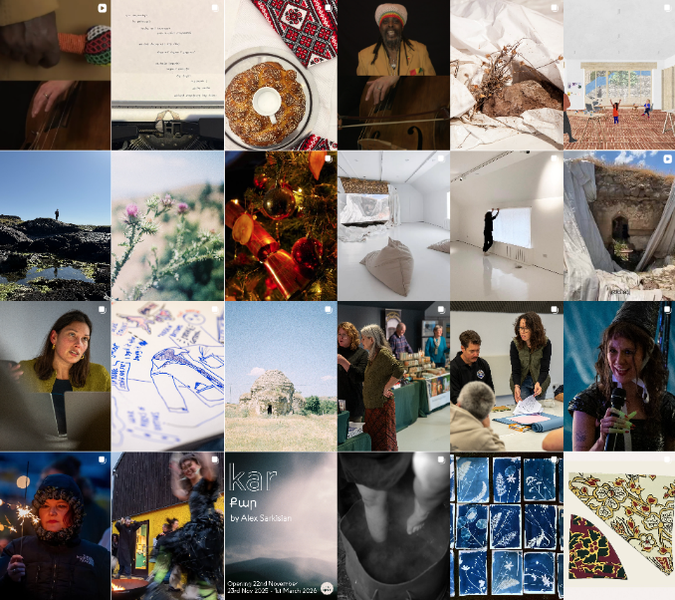
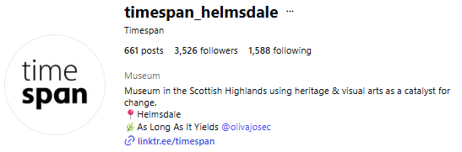
Bold
Sleek
Vibrant
Edgy
Outward-looking

Slide 18
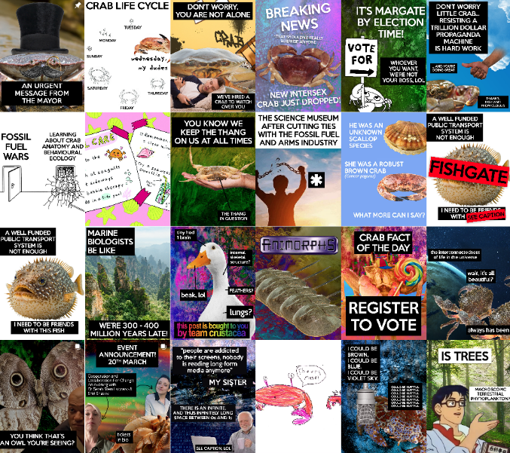
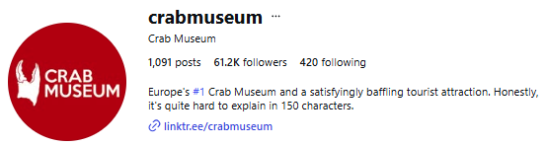
Quirky
Confident
Light-hearted
Energetic
Focused on values,
not collections

Slide 19
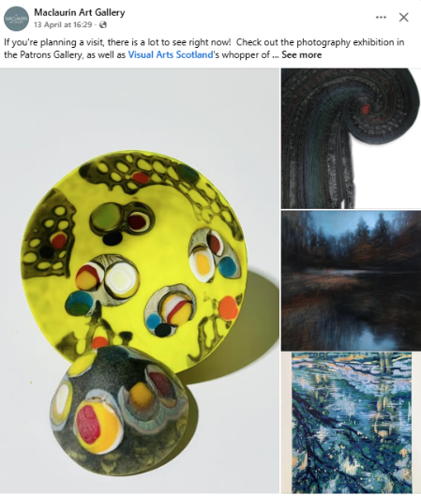
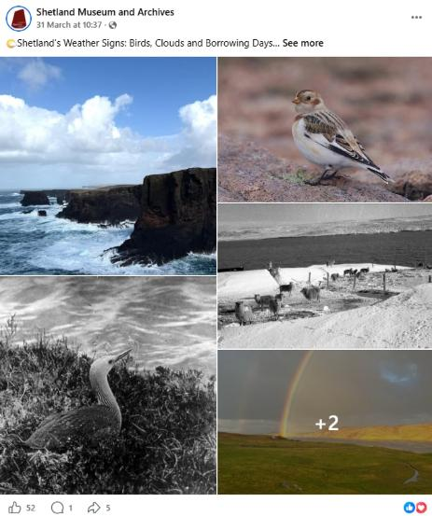
Your aim: get people to stop scrolling!
Take up space • use bold colours • share intriguing details • embrace your surroundings • share quality images
Notes:
Your aim is to get people to stop in their tracks – so take up plenty of space on the news feed, and use eye-catching visuals! Bright colours, intriguing details, and posts that feature people having fun. Showcase your surroundings, like in this example from Shetland Museum and Archives. Their post also does a great job of incorporating collections photography.
What gets you to stop scrolling when you’re browsing social media?

Slide 20
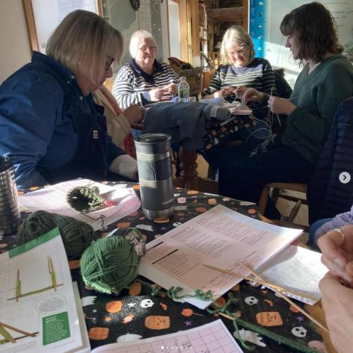
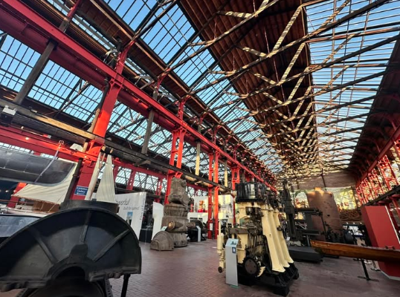
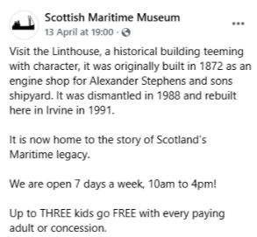
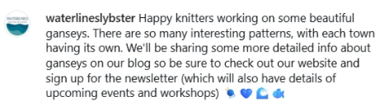
Your aim: get people to stop scrolling!
Showcase vibrant spaces • feature familiar faces • look for light and contrast • add calls-to-action
Notes:
You want to portray your museum as a fun, vibrant, and successful space. Feature familiar faces and popular local figures.
Note how the photos above make use of light and contrast to create eye-catching images.
Make your content work harder by adding calls-to-action to posts that you think will be popular.

Slide 21
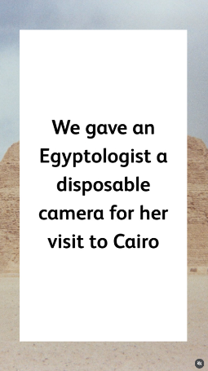
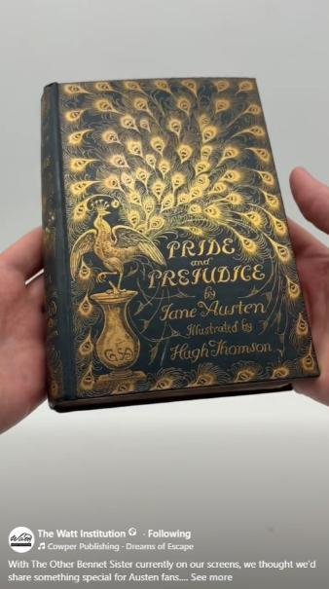
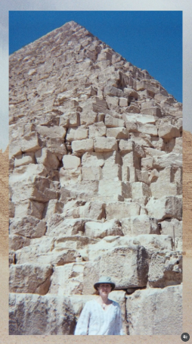
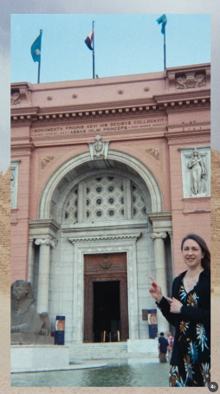
What do you personally enjoy experiencing on social media?
How can your social media tap into popular topics?

Slide 22
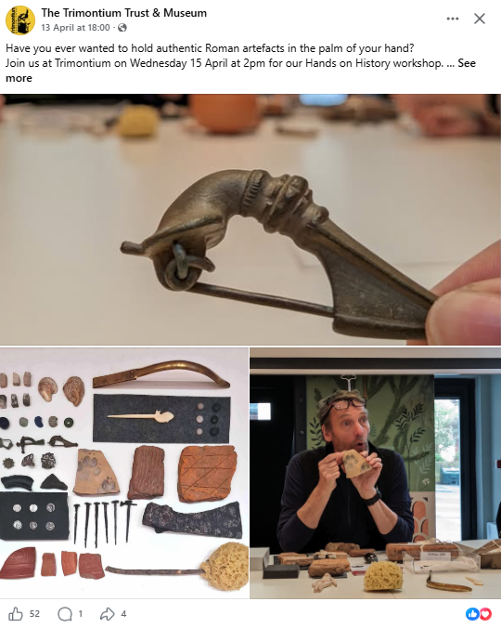
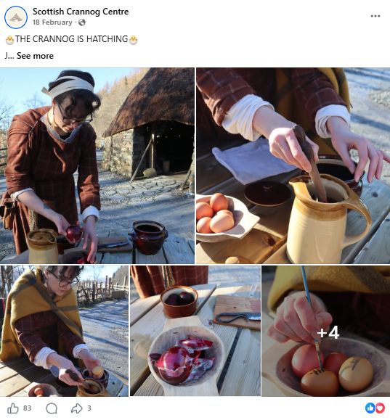
Promoting events
Notes:
The images on this slide are great as standalone posts – with the added benefit of a call-to-action. This can be a good way to promote events - the more people you reach, the greater your chance of getting on the radar of potential attendees.
I’m noticing museums using AI images to promote events – please be really careful with this, as you don’t want to set unrealistic expectations for your audiences.

Slide 23
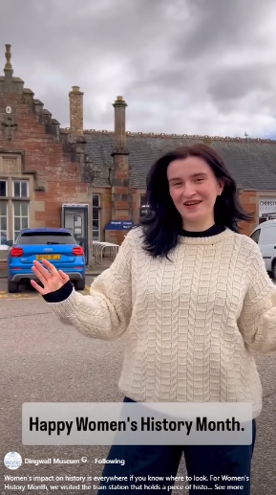
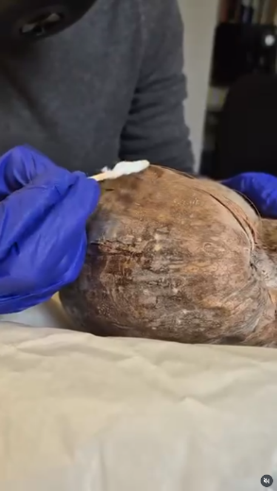
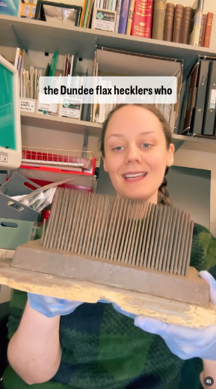
Video content - showcasing your skills
Local history
Dingwall Museum
90 likes, 14k views
Object conservation
Dumfries Museum
37 likes, 2.8k views
Object history
Nairn Museum
55k likes, 1m views
Notes:
Social media algorithms tend to reward video content.
When creating video content, aim to showcase authentic enthusiasm and find ways to connect with your community. You can save time by filming work you’re already doing.
Note the use of captions in these videos – many people will scroll through social media without the sound on, so captions are essential. If you’re creating Reels for Instagram, Meta’s official ‘Edits’ app has the option to auto-generate captions.
Always get straight to the point with social media videos: attention spans are short, and the first 2 seconds of a video needs to effectively set the tone.

Slide 24
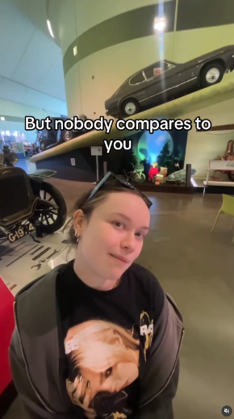
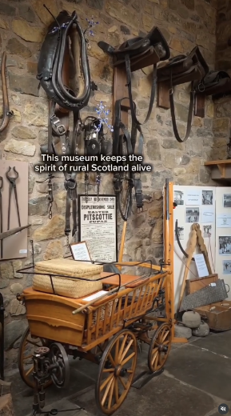
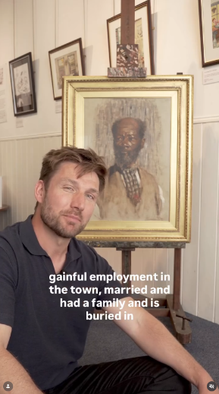
Video content - Influencers
@whatsername1.0
Riverside Museum
36k likes, 500k views
@scotlandhiddenadventures
Fife Folk Museum
5.5k likes, 330k views
@historic_ally
Montrose Museum
5k likes, 190k views
Notes:
Influencers can unlock access to massive audiences. This can be a paid promotion featuring an influencer whose work intersects with yours, or a chance interaction with an influencer who is inspired by your museum.
We have a Knowledge Exchange on how you can work with influencers: https://www.museumsgalleriesscotland.org.uk/advice-article/knowledge-exchange-working-with-influencers/
Monitor your mentions regularly, as you never know when a piece of third-party content featuring your museum might take off! If this happens, aim to engage positively with the content.

Slide 25
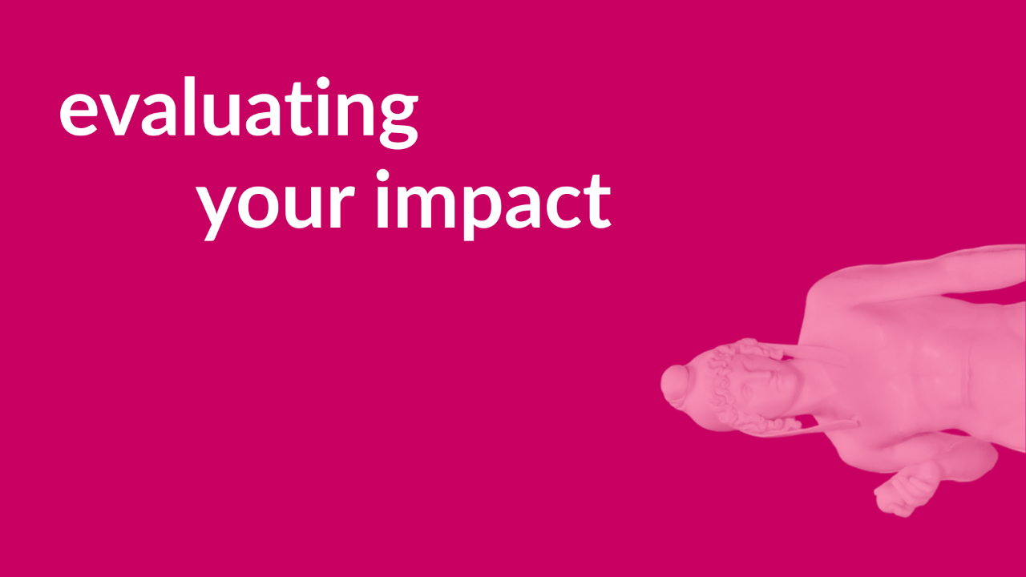
Evaluating Your Impact

Slide 26
Evaluating your impact
Regular reflection (every 1 or 2 months, or at the end of a project)
Aim for steady, sustained engagement
What sort of growth are you aiming for?
Calculate your averages. (e.g. average reach per post, average engagement rate per post)
How do you compare to other attractions in your area, or museums with a similar size/budget/remit?
How did your visitors and event attendees find out about you?
Notes:
Carve out some time for regular reflection on your social media performance (every 1 or 2 months, or at the end of a project). We have more information on evaluations in our Social Media Toolkit.
If something isn’t working – can it be tweaked, or should it be scrapped? Is it just not right for this channel – will it work better on a different channel, or off social media entirely?
Aim for steady, sustained engagement (quality experience) on social media.
What sort of growth are you aiming for? (if your focus is on your local community, that’s going to look very different to a museum chasing viral success)
Calculate your averages. (e.g. average reach per post, average engagement rate per post). This will give more reliable data than month-by-month calculations.
How are you comparing to other attractions in your area, or museums with a similar size/budget/remit? Is there anything you can learn from them?
How did your visitors and event attendees find out about you? (collecting this information will help you measure the impact of your social media)

Slide 27
Museum Futures | Lunch & Learn
Thank you!
Contact me:
joes@museumsgalleriesscotland.org.uk

